Slide 1
UDP Programming

Slide 2
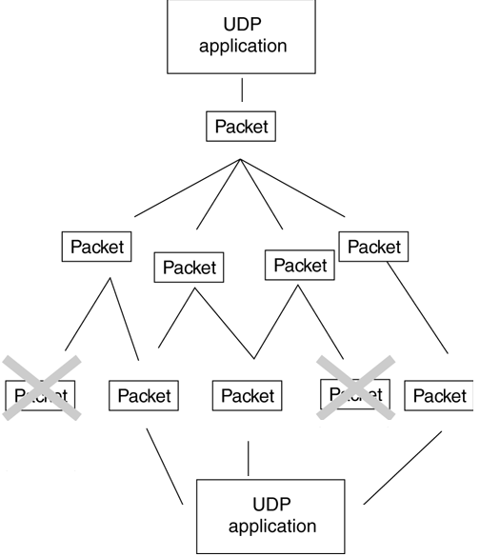
Overview

Slide 3
Overview
UDP communication can be more efficient than guaranteed-delivery data streams. If the amount of data is small and the data is sent frequently, it may make sense to avoid the overhead of guaranteed delivery.
Unlike TCP streams, which establish a connection, UDP causes fewer overheads. If the amount of data being sent is small and the data is sent infrequently, the overhead of establishing a connection might not be worth it.
Real-time applications that demand up-to-the-second or better performance may be candidates for UDP, as there are fewer delays due to the error checking and flow control of TCP. UDP packets can be used to saturate available network bandwidth to deliver large amounts of data (such as streaming video/audio, or telemetry data for a multiplayer network game). In addition, if some data is lost, it can be replaced by the next set of packets with updated information, eliminating the need to resend old data that is now out of date.
UDP sockets can receive data from more than one host machine. If several machines must be communicated with, then UDP may be more convenient than other mechanisms such as TCP.

Slide 4
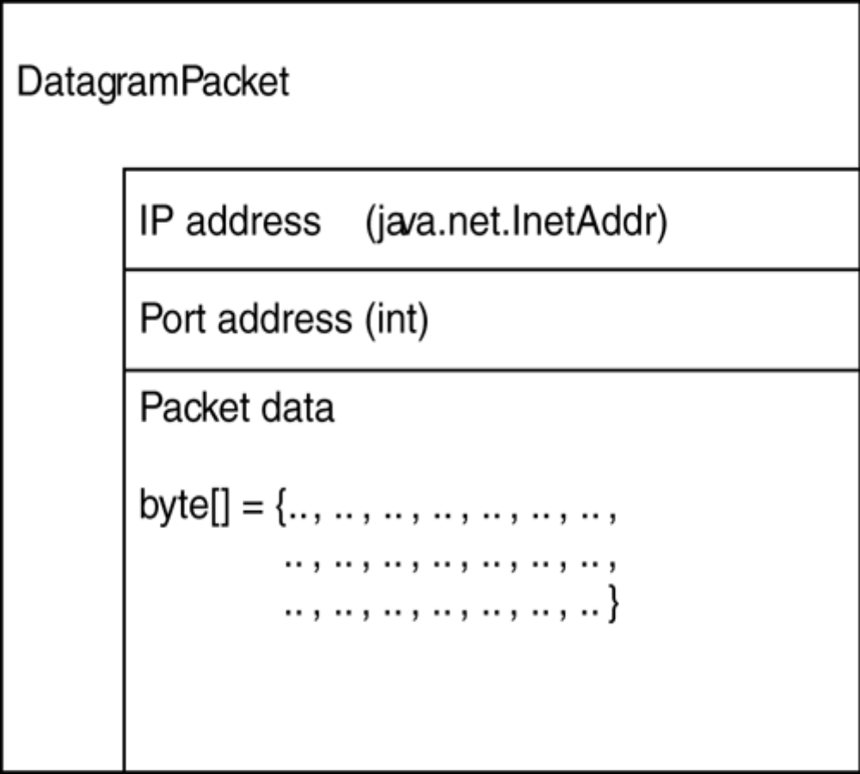
DatagramPacket Class
Port (Remote Port)
DataPacket(port)
…setPort(port)

Slide 5
Creating a DatagramPacket
Constructor requires the specification of a byte array, which will be used to store the UDP packet contents, and the length of the data packet.
There are two reasons to create a new DatagramPacket:
1.To send data to a remote machine using UDP
DatagramPacket(byte[] buffer, int length, InetAddress
dest_addr, int dest_port).
For example:
InetAddress addr = InetAddress.getByName("192.168.0.1");
DatagramPacket packet = new DatagramPacket ( new byte[128],128, addr, 2000);
2.To receive data sent by a remote machine using UDP
DatagramPacket(byte[] buffer, int length). For example:
DatagramPacket packet = new DatagramPacket(new byte[256], 256);

Slide 6
Using a DatagramPacket
InetAddress getAddress()— returns the IP address from which a DatagramPacket was sent, or (if the packet is going to be sent to a remote machine), the destination IP address.
byte[] getData()— returns the contents of the DatagramPacket, represented as an array of bytes.
int getLength()— returns the length of the data stored in a DatagramPacket. This can be less than the actual size of the data buffer.
int getPort()— returns the port number from which a DatagramPacket was sent,or (if the packet is going to be sent to a remote machine), the destination port number.

Slide 7
Using a DatagramPacket
void setAddress(InetAddress addr)— assigns a new destination address to a DatagramPacket.
void setData(byte[] buffer)— assigns a new data buffer to the DatagramPacket. Remember to make the buffer long enough, to prevent data loss.
void setLength(int length)— assigns a new length to the DatagramPacket. Remember that the length must be less than or equal to the maximum size of the data buffer, or an IllegalArgumentException will be thrown. When sending a smaller amount of data, you can adjust the length to fit—you do not need to resize the data buffer.
void setPort(int port)— assigns a new destination port to a DatagramPacket.

Slide 8
DatagramSocket Class
The DatagramSocket class provides access to a UDP socket, which allows UDP packets to be sent and received. A DatagramPacket is used to represent a UDP packet, and must be created prior to receiving any packets. The same DatagramSocket can be used to receive packets as well as to send them. However, read operations are blocking, meaning that the application will continue to wait until a packet arrives.
A DatagramSocket can be used to both send and receive packets. Each DatagramSocket binds to a port on the local machine, which is used for addressing packets. The application is a UDP server, it will usually choose a specific port number. If the DatagramSocket is intended to be a client, and doesn't need to bind to a specific port number, a blank constructor can be specified.

Slide 9
Creating a DatagramSocket
To create a client DatagramSocket, the following constructor is used:
DatagramSocket() throws java.net.SocketException.
To create a server DatagramSocket, the following constructor is used, which takes as a parameter the port to which the UDP service will be bound:
DatagramSocket(int port) throws java.net.SocketException.
Although rarely used, there is a third constructor for DatagramSocket. If a machine is known by several IP addresses, you can specify the IP address and port to which a UDP service should be bound. It takes as parameters the port to which the UDP service will be bound, as well as the InetAddress of the service. This constructor is:
DatagramSocket (int port, InetAddress addr) throwsjava.net.SocketException.
Port is Local !!!

Slide 10
Using a DatagramSocket
void close()— closes a socket, and unbinds it from the local port.
void connect(InetAddress remote_addr int remote_port)— restricts access to the specified remote address and port. The designation is a misnomer, as UDP doesn't actually create a "connection" between one machine and another.
void disconnect()— disconnects the DatagramSocket and removes any restrictions imposed on it by an earlier connect operation.
!!! Sai InetAddress getInetAddress()— returns the remote address to which the socket is connected, or null if no such connection exists.
int getPort()— returns the remote port to which the socket is connected, or –1 if no such connection exists.
InetAddress getLocalAddress()— returns the local address to which the socket is bound.
int getLocalPort()— returns the local port to which the socket is bound.
int getReceiveBufferSize() throws java.net.SocketException— returns the maximum buffer size used for incoming UDP packets.

Slide 11
Using a DatagramSocket
int getSendBufferSize() throws java.net.SocketException— returns the maximum buffer size used for outgoing UDP packets.
int getSoTimeout() throws java.net.SocketException— returns the value of the timeout socket option. By default, this value will be zero, indicating that blocking I/O will be used.
void receive(DatagramPacket packet) throws java.io.IOException— reads a UDP packet and stores the contents in the specified packet. The address and port fields of the packet will be overwritten with the sender address and port fields, and the length field of the packet will contain the length of the original packet, which can be less than the size of the packet's byte-array. If a timeout value has been specified, a java.io.InterruptedIOException will be thrown if the time is exceeded.
void send(DatagramPacket packet) throws java.io.IOException— sends a UDP packet, represented by the specified packet parameter.

Slide 12
Using a DatagramSocket
void setReceiveBufferSize(int length) throws java.net.SocketException— sets the maximum buffer size used for incoming UDP packets. Whether the specified length will be adhered to is dependent on the operating system.
void setSendBufferSize(int length) throws java.net.SocketException— sets the maximum buffer size used for outgoing UDP packets. Whether the specified length will be adhered to is dependent on the operating system.
void setSoTimeout(int duration) throws java.net.SocketException— sets the value of the timeout socket option. This value is the number of milliseconds a read operation will block before throwing a java.io.InterruptedIOException.

Slide 13
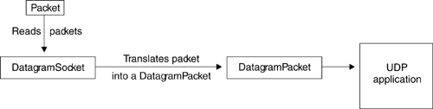
Listening for UDP Packets
UDP packets are received by a DatagramSocket and translated into a DatagramPacket object.
When an application wishes to read UDP packets, it calls the DatagramSocket.receive method, which copies a UDP packet into the specified DatagramPacket. The contents of the DatagramPacket are processed, and the process is repeated as needed.

Slide 14
Listening for UDP Packets
DatagramPacket packet = new DatagramPacket (new byte[256], 256);
DatagramSocket socket = new DatagramSocket(2000);
boolean finished = false;
while (! finished ){
socket.receive (packet);
// process the packet
}
socket.close();
When processing the packet, the application must work directly with an array of bytes. If, however, your application is better suited to reading text, you can use classes from the Java I/O package to convert between a byte array and another type of stream or reader. By hooking a ByteArrayInputStream to the contents of a datagram and then to another type of InputStream or an InputStreamReader, you can access the contents of UDP packets relatively easily. Many developers prefer to use Java I/O streams to process data, using a DataInputStream or a BufferedReader to access the contents of byte arrays.

Slide 15
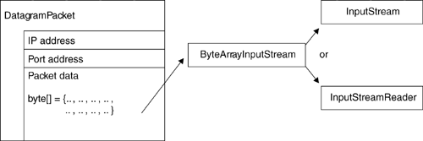
Listening for UDP Packets
ByteArrayInputStream bin = new ByteArrayInputStream(packet.getData() );
DataInputStream din = new DataInputStream (bin);
// Read the contents of the UDP packet
.......

Slide 16
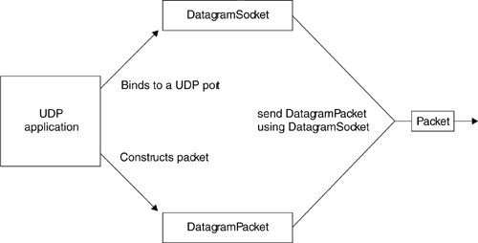
Sending UDP packets

Slide 17
Sending UDP packets
DatagramSocket socket = new DatagramSocket();
DatagramPacket packet = new DatagramPacket (new byte[256],256);
packet.setAddress (InetAddress.getByName (someServer));
packet.setPort (2000);
boolean finished = false;
while !finished ){
// Write data to packet buffer
.........
packet.setData(…..);
packet.setLength(…);
socket.send (packet);
// Do something else, like read other packets, or check to
// see if no more packets to send
.........
}
socket.close();

Slide 18
UDP PacketReceiveDemo - Server
The application starts by binding to a specific port, 2000. Applications offering a service generally bind to a specific port. When acting as a receiver, your application should choose a specific port number, so that a sender can send UDP packets to this port. Next, the application prepares a DatagramPacket for storing UDP packets, and creates a new buffer for storing packet data.
// Create a datagram socket, bound to the specific port 2000
DatagramSocket socket = new DatagramSocket(2000);
System.out.println ("Bound to local port " +
socket.getLocalPort());
// Create a datagram packet, containing a maximum buffer of 256 bytes
DatagramPacket packet = new DatagramPacket(new byte[256], 256);

Slide 19
UDP PacketReceiveDemo - Server
Now the application is ready to read a packet. The read operation is blocking, so until a packet arrives, the server will wait. When a packet is successfully delivered to the application, the addressing information for the packet is displayed so that it can be determined where it came from.
// Receive a packet - remember by default this is a blocking
// operation
socket.receive(packet);
// Display packet information
InetAddress remote_addr = packet.getAddress();
System.out.println ("Sent by : " + remote_addr.getHostAddress() );
System.out.println ("Send from: " + packet.getPort());

Slide 20
UDP PacketReceiveDemo - Server
To provide easy access to the contents of the UDP packet, the application uses a ByteArrayInputStream a DataInputStream to read from the packet. Reading one character at a time, the program displays the contents of the packet and then finishes.
// Display packet contents, by reading from byte array
DataInputStream din = new DataInputStream(new ByteArrayInputStream(packet.getData()));
// Display only up to the length of the original UDP packet
for (int i = 0; i < packet.getLength()/2; i++) {
System.out.print(din.readChar());
}
socket.close();
}

Slide 21
UDP PacketSendDemo - Client
The application starts by binding a UDP socket to a local port, which will be used to send the data packet. Unlike the receiver demonstration, it doesn't matter which local port is being used. In fact, any free port is a candidate, and you may find that running the application several times will result in different port numbers. After binding to a port, the port number is displayed to demonstrate this.
// Create a datagram socket, bound to any available local port
DatagramSocket socket = new DatagramSocket();
System.out.println ("Bound to local port " +
socket.getLocalPort());
Before sending any data, we need to create a DatagramPacket. First, a ByteArrayOutputStream is used to create a sequence of bytes. Once this is complete, the array of bytes is passed to the DatagramPacket constructor.

Slide 22
UDP PacketSendDemo - Client
// Create a message to send using a UDP packet
ByteArrayOutputStream bout = new ByteArrayOutputStream();
DataOutputStream dout = new DataOutputStream(bout);
dout.writeChars("Greetings!");
// Get the contents of our message as an array of bytes
byte[] barray = bout.toByteArray();
// Create a datagram packet, containing our byte array
DatagramPacket packet = new DatagramPacket(barray, barray.length);
Now that the packet has some data, it needs to be correctly addressed. As with a postal message, if it lacks correct address information it cannot be delivered. We start by obtaining an InetAddress for the remote machine, and then display its IP address. This InetAddress is passed to the setAddress method of DatagramPacket, ensuring that it will arrive at the correct machine. However, we must go one step further and specify a port number. In this case, port 2000 is matched, as the receiver will be bound to that port.

Slide 23
UDP PacketSendDemo - Client
System.out.println ("Looking up hostname " + hostname );
// Lookup the specified hostname, and get an InetAddress
InetAddress remote_addr = InetAddress.getByName(hostname);
System.out.println ("Hostname resolved as " +
remote_addr.getHostAddress());
// Address packet to sender
packet.setAddress (remote_addr);
// Set port number to 2000
packet.setPort (2000);
// Send the packet - remember no guarantee of delivery
socket.send(packet);

